Slide 1
Final Projects
CSCI 601 471/671
NLP: Self-Supervised Models
https://self-supervised.cs.jhu.edu/sp2023/
[Slide credit: Chris Manning]

Slide 2
Overview
30% of your overall grade (proposal, midway presentation, final report and poster)
The objective of the final project is to
make use of what you have learned during this course
to solve a hard problem.
What is “a hard problem”?
Go beyond what has been done.
Identify their weaknesses or make them better.
Or make something completely new!
(more on this in a bit.)

Slide 3
Overview: Topic
The topic of this project is open-ended.
This project, for example, can focus on
demonstrating systemic limitations of prior work or
suggesting improvements on methods
or benchmarks discussed in the class.
Etc.
Really, anything!
Must substantively involve human language!

Slide 4
Overview: Risk Factor
Failure is an option!
Negative results are valuable.
You'd get credit regardless of whether an idea works or not.
This should encourage you to take risky bets (that we approve of).
Note that: negative result != no result
"The only people who never fail are those who never try." — Ilka Chase

Slide 5
Overview: Honor Code
Group work: Students can work in groups (team sizes 1-3 people).
Being in a team is encouraged.
A larger team project or a project used for multiple classes should be broader and involves exploring more models/tasks/analysis.
If multi-person: Include a brief statement on the work of each teammate
In almost all cases, each team member gets the same score, but we reserve the right to differentiate in egregious cases
It’s okay (and encouraged) to use existing code/resources
Don't re-invent the wheel.
You must document it and give them credit .
You will be graded on your value-add.
Use any language/framework for your project. Though we expect most will use PyTorch.

Slide 6
Overview: Mentorship
You have access to the mentorship of the course staff throughout!
You will be aligned with at least one (possibly two) course staff.
I would love to talk to each team, alas there is only one of me …
You must meet them at least once every 2 weeks to discuss your progress or hurdles.
It’s your 🫵 job to reach out to them to coordinate times, in case office hours do not fit your schedule.

Slide 7

Timeline: Project Teaming Extravaganza (Mar 9-16)
There will be a spreadsheet with ideas (will be shared on Piazza)
🖋️ You can add your ideas
🖋️ Put names for other ideas that you’re interested in
🤝 Reach out to others to discuss ideas and discuss teaming options
Initially, you can add your names for multiple projects, but ultimately need to converge on one idea.
Too many people on one idea? Split into multiple teams

Slide 8
Timeline: Project Proposals (March 16)
All groups will be required to submit a project proposal.
via Gradescope.
The project proposal is a 2 page description of what you intend to do
motivation,
hypothesis,
experiments,
datasets,
methods,
expected outcome,
etc.

Slide 9
Timeline: Project Proposals: How t go about it
How to think critically (about an existing paper, application, etc.)
What were the main novel contributions or points?
Is what makes it work something general and reusable or a special case?
Are there flaws or neat details in what they did?
How does it fit with other papers on similar topics?
Does it provoke good questions on further or different things to try?
You need to have an overall sensible idea (!)
Do you have appropriate data or a realistic plant to be able to collect it in a short period of time
Do you have a realistic way to evaluate your work
Do you have appropriate baselines or proposed ablation studies for comparisons
Ask for help if needed
I encourage you to talk to all course staff about your project ideas.
If I had ∞ time, I would talk to all of you. Sadly, that won’t happen.

Slide 10
Timeline: Project Proposals
One way to go about it:
Find a key, relevant existing work — e.g., a research paper for your topic.
write a summary of the existing work,
what you took away from it and
your perceived limitations/potentials of it,
…
Write what you plan to work on and how can innovate in your final project.
Suggest a good milestone to achieve as halfway point.
Describe as needed: A project plan, relevant existing literature, the kind(s) of models you will use/explore; the data you will use (and how it is obtained), and how you will evaluate success.

Slide 11
Timeline: Feedback on Project Proposals
You will receive feedback from the course staff on your proposals
You should receive it before the end of spring break
The purpose is to help the teams with finding a concrete idea.
Hopefully often the feedback will be light.
If there is need for significant changes in the proposal, we will ask you to redo your proposal and resubmit (Tuesday March 28).

Slide 12
Timeline: Midway Report (April 18)
This is a progress report — Max 5 pages, via Gradescope.
Should be more than halfway done!
Describe the progress made
Experiments you have run
Preliminary results you have obtained
how you plan to spend the rest of your time.
….
You’re expected to have implemented some system, and to have some experimental results to show by this date.

Slide 13
Timeline: Final Report (date: TBD)
You will write up the results in a report.
Should be max 8 pages, on Gradescope.
The final report should summarize your findings and answer the following questions:
Motivation: What approach did you take to address this problem, and why?
Related work: How did you explore the space of solutions?
Approach: How did you pick your solution?
Evaluation: How did you evaluate the performance of the approach(es) you investigated?
Findings: What worked, what did not work, and why?
Conclusion and future work
Writeup quality is very important for your grade!

Slide 14
Timeline: Final Poster (date: TBD)
All students will present their findings at a poster presentation during the final exam period.
Then we will celebrate! 🎉
Best Project Awards !
Selected by course staff
Popular vote by the class
Awards details are TBD

Slide 15
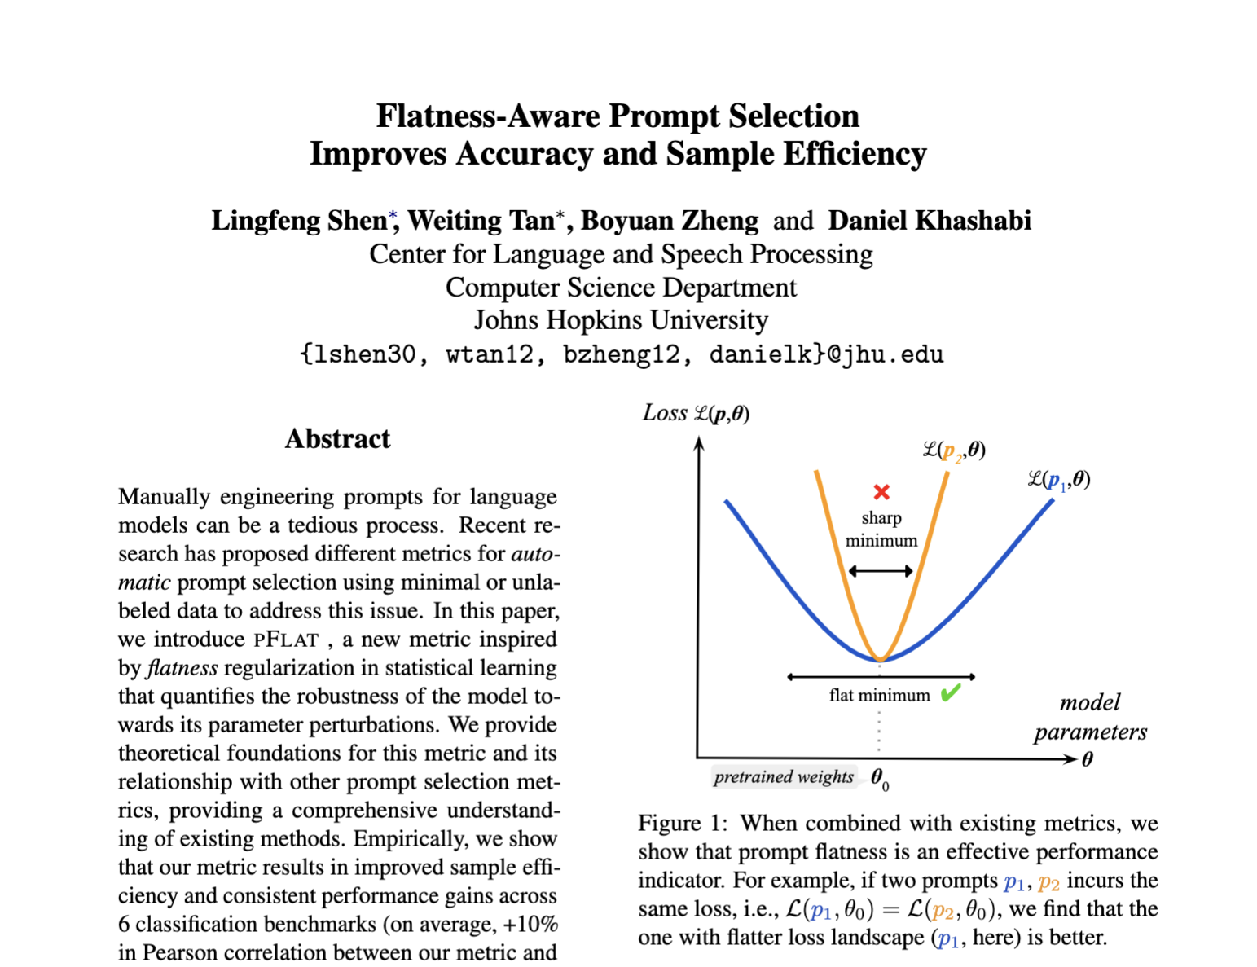
And then what?
You may move on and have a great life! 😊
You may also choose to extend your findings into a paper.
It’s your choice
Typically requires substantial work beyond what you do here ….

Slide 16
How should I find
a project idea? 🤔

Slide 17
Finding Project Ideas
Two basic starting points, for all of science:
[Nails] Start with a (domain) problem of interest and try to find good/better ways to address it than are currently known/used
[Hammers] Start with a technical method/approach of interest, and work out good ways to extend it, improve it, understand it, or find new ways to apply it

Slide 18
Train Your Models for Your Target
Pick an application that you care about or you already work on.
Your project may involve building a variety of models to improve the performance on your application.
Can involve training or fine-tuning many medium-sized language models (e.g., BERT/RoBERTa, T5) for an important application.

Slide 19
If you feel 🚀adventurous🚀 ….

Slide 20
Scaling Models by Combining Many Small Models
Motivation: can we scale models by combing many small models? Specifically, can we train M₁, M₂, ..., M_{n} so that:
perf( combination(M₁, M₂, ..., M_{n}) ) ~ perf(M) while size (M_i) << size (M)
An approach could be based based on “Boosting”
Train M1,
then train M2 to be complementary to M1,
then train M3 to be complementary to M1 + M2, …
…

Slide 21
Pre-training Once vs Many Random Initializations
Motivation: pre-training is worth how many random initializations?
Setup: suppose give you $X worth of compute to build the best model you can.
Typically, we would spend $X to pre-train a good model, and then fine-tune it on our labeled data.
What if we do something strange:
While you can spend your $X compute budget:
Initialize the model with random parameters and fine-tune it with labeled data
If this is a good model, remember it.
Repeat this
How good will (2) be compared to (1)? This is a surprisingly non-trivial question answer! ☺

Slide 22
Articulate When You Don't Know
Motivation: Many of our demands are often underspecified and hence, the answer to them require follow up questions.
Example: Suppose you're a programmer asking questions from a lang-to-code model.
Not everything you say the model will be clear to the model
Typos, undefined variable names, complex demands, etc.
Current models usually hallucinate responses when they don’t understand.
Can we make LMs articulate what they don't understand?

Slide 23
Better Pre-training by Sorting Data
Context: currently we train our models on randomly-ordered data. Is it possible to sort the data such that pre-training happens more efficiently? Specifically, if each batch of pre-training data are more contextually similar, LMs might learn the patterns much faster.
How do you quickly group together data that are contextually similar?
You can embed sentences with a sub-model (or another model, say BERT) and group them based on their distances.
Retrieval engines (e.g., Elastic Search) can help with quick computation of nearest-neighbor search.

Slide 24
Better Pre-training by Filtering Data
Context: currently we train our models on mostly random extracted data from the web. Can we aggressively filter the data such that we pre-trained on the most important portions of the data?
Broader literature: there has been some work on data deduplication (cite, cite) and pruning (cite).

Slide 25
State-Space Models vs Transformers
Background: State-space models are shown to quite effective at capturing long-range dependencies (cite, cite, cite).
Motivation: How are these models connected to Transformers?
The goal here is basically to find the conditions under which either of these architectures is reduced to one other.
One can use such reductions to find properties that make one

Slide 26
Know When To Use Your API (Calculator/Python/….)
There are many works that decompose a complex task into substeps that can be passed on to APIs such as Python code.
A key bottleneck of these works is their reliance on examples that assume a particular structure that may not generalize to many other problems.
Is it possible to pre-train models such that they learn when to use APIs as part of their pre-training?
You may want to investigate recent works such as ToolFormer and build on them.

Slide 27
The Role of Creativity in the Age of Self-Supervised Models
Motivation: with availability of these models everywhere (image generation, poetry generation, etc.) what is the role of creative work? What does “creativity” even mean? Do we still need art?
The goal here is to try to define various axes that characterize creative work.
There is plenty of literature on this in humanities.
Based on a carefully crafted definition for ”creativity”, then let’s evaluative “creative” decision-making of our best models.

Slide 28
Code Editing via Language Instructions
Motivation: How can we build a system that can take in commands to edit codes?
Input: current code, command detailing how to edit code
Output: modified code
One might be able to do something similar to InstructPix2Pix.
Basically, build “InstructCode2Code”

Slide 29
ChatGPT with Grounded Generations
Motivation: let’s build a chatbot that would “cite” its sources!
This important because:
It might prevent model hallucinations
Would allow to update model knowledge — if the sources change, we can cite the updated sources.
You might be able to come up with creative ideas based on the recent retrieval-augmented language models, such as NPM.

Slide 30
When ICL == GD and when ICL != GD
Background: Several recent work argue that in-context learning might effectively be a gradient-descent optimizer (cite, cite, cite, cite). However, these arguments all depend on many assumptions.
What is more likely is that, under certain conditions ICL == GD and otherwise for some other conditions.
Do a comprehensive analysis to figure out when ICL == GD and when not.

Slide 31
Models of Internet Navigation
Motivation: Let’s build models that accept language instructions to execute actions that we typically do manually through web navigation!
Example commands to the model:
Post happy birthday on John’s Doe’s Facebook feed
Open a Google Doc, write a summary on Transormers and share it with John Doe
Download the PDF slides from my CS 601.471/671 course, and turn them to PPT with an online tool

Slide 32
Phrase Transition with Window Size
Consider the following thought experiment where the window size of your language model is extremely large (say, close to ∞).
A model with an extremely large context would overfit the pretraining data and would not learn an exciting behavior (e.g. in-context learning, poetry, etc.)
On other hand, an extremely small (say, 1-2) is also not enough to learn anything meaningful about language.
This might suggest that there is an optimal window size that depends on the data (size, diversity, length, etc.) and architecture.
There are also phase transitions from trivial memorizing to emergent phenomena as a function of this window size.
The idea is to define empirical and/or theoretical frameworks to analyze these.

Slide 33
Transformer vs MLP
Context: Similar to MLPs, Transformers are also fixed-window architectures.
Investigate, theoretically or empirically, what makes Transformers superior to MLPs.

Slide 34
Better In-Context Learning
Motivation: let’s build LMs are specialized for in-context learning.
The current design of LMs is somewhat generic for any use-cases.
However, we can engineer the models knowing that they will be used for ICL.

Slide 35
Prompt Hacking
Show that it is possible to get higher scores with extremely-engineered prompts
However, such prompts will not necessarily generalize well across different models
In a way, by over-engineering (“hacking”) prompts, we build models that have less generalizability across different architectures.
This probably requires experimenting on very large models, such as GPT3 variants (via OpenAI's playground) or Bloom (available via Petals) or OPT (runnable on Rockfish).

Slide 36
Finding Contradictions in Text
Motivation: if someone gives you written text, can we use LM to detect false or unsubstantiated arguments in text?
Input: A document/report/essay
Output (level 1): weak arguments in the text, including false conclusions such as contradictions, or unsubstantiated takeaways (as leaps of faith)
Output (level 2): suggestions to improve the above issues

Slide 37
RL vs. HF
Background: RLHF is a set of algorithms for aligning LMs with human feedback (cite, cite, cite).
Motivation: There is plenty of recent work on RLHF and its benefits. However, from these works it is not clear whether RL is more important or HF. That motivates us to tease apart the importance of RL vs. HF.
Is there a way to quantify the con0tribution of each of these ingredients?

Slide 38
Importance of Feedback Quality/Quantity in RLHF
Background: RLHF is a set of algorithms for aligning LMs with human feedback (cite, cite, cite).
Motivation: There is plenty of recent work on RLHF and its benefits. However, from these works, it is not clear how what kind of HF is good.
That motivates us to study various parameters related to HF.
For example:
Size of HF
Quality of HF
Length of HF
Diversity of HF
….
Can we design a reasonable set of controlled experiments to study these parameters?

Slide 39
Offline RL(HF)
Background: RLHF is a set of algorithms for aligning LMs with human feedback (cite, cite, cite).
A bottleneck in these is their dependence on massive amounts human annotations.
There are plenty of information out there that come with their ratings.
Take, for example, responses posted to discussion forums.
One can use such ratings (or ranking of the solutions) as a useful signal to simulate an offline RLHF.
How effective will be running RLHF with such ratings?

Slide 40
RLHF with Model’s Own Feedback (RLMF)
Background: RLHF is a set of algorithms for aligning LMs with human feedback (cite, cite, cite).
Motivation: can do RLHF with LM’s own feedback signals?
The recent work on self-instruct and unnatural-instructions show that one can extract useful instructions from a model itself.
How useful it would be to use the same feedback signal in an RL loop?

Slide 41
An Impossibility Result for Watermarking
Background: the goal of “watermarking” is to be able to distinguish machine generation vs. human generations (cite, cite, cite).
Hypothesis: there is no algorithm that can confidently distinguish human vs generations of any model.
Goal:
Come up with a bunch of reasonable assumptions that are likely to be true.
Under your choice of (hopefully, reasonable) assumptions, prove that there is no algorithm that can confidently distinguish machine vs human generation.

Slide 42
Gradient-Free Training of LMs
Existing algorithms for training LMs use gradients.
What if we use gradient-free optimization (e.g., SPSA)?
Since gradient computation take up a lot of GPU, using gradient-free optimization would allow training larger models at a lower training speed.
So, the project’s goal is to study the trade-off between model size and optimization speed.
There is also a room for hybrid setups: One could start training a model with gradient optimization. After saturations, we can add more layers and continue training this larger model with gradient-free optimization.

Slide 43
Forgetful Models in Retrieval-Augmented LMs
Retrieval-Augmented LMs are supposed to lookup their knowledge from retrieved documents. That doesn’t always happen; they may retrieve information from their parameters (cite).
How can we force the LMs (neural network) component of retrieved LMs to be ”forgetful” so that they always lookup information from their retrieved documents?
One way might be to use data-augmentation which is not necessarily efficient.

Slide 44
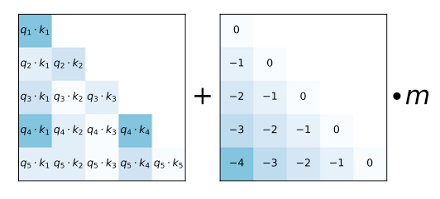
Exploring Alternatives to ALiBI Positional Embeddings
ALiBI is a recent proposal that simplifies that simplifies the positional embeddings of self-attention. It essentially adds linear weights to unnormalized attention weights (shown in fig).
The goal of this project is to try other (potentially simpler( variants to AliBI.
Multiplicative instead of additive
All rows the same (i.e., queries see different positions but not keys)
All columns the same (i.e., keys see different positions but not queries)
Other step sizes (rather than units of 1).

Slide 45
Impact of Dropping Positional Embeddings for Encoder Models
Recent work has shown that dropping positional embeddings does not impact quality of decoder-only models.
It is not trivially clear whether this result would generalize to decoder-only models.
The goal of this project is to train BERT-like or T5-like models without positional embeddings and evaluate their performance.

Slide 46
Multi-step Prompting vs Long Tail
Motivation: quantify the gains of multi-step reasoning in the long tail.
There are several works that study the long-tail phenomena (cite, cite).
Approach 1: we can take math word problems, change the range of the values in these numbers and quantify the gains as a function of the frequency of the numbers in pre-training data.
Approach 2: Use TriviaQA questions (for which we haver frequency information) to build compositional questions. Then evaluate multi-step prompting on these compositional questions.

Slide 47
Diversity-Inducing Instruction-Tuning
Motivation: a big argument for using RL over supervised learning is that RL can lead to models that provide more diverse outputs.
Idea: modify the objective of supervised learning to produce diverse outputs.
Challenge: we'd need multiple gold outputs for each instructions.
Approach: we can use self-instruct to generate multiple outputs. And then supervised train LMs with a diversity-inducing objective — i.e., the optimization would get credit, regardless of which output we generate.

Slide 48
Reflective Multi-Step Prompting
Merging reflective decoding with multi-step prompting

Slide 49
New Demos/Applications
Passionate about building a useful demo/tool?
Something that people would use immediately?
Some examples:

Slide 50
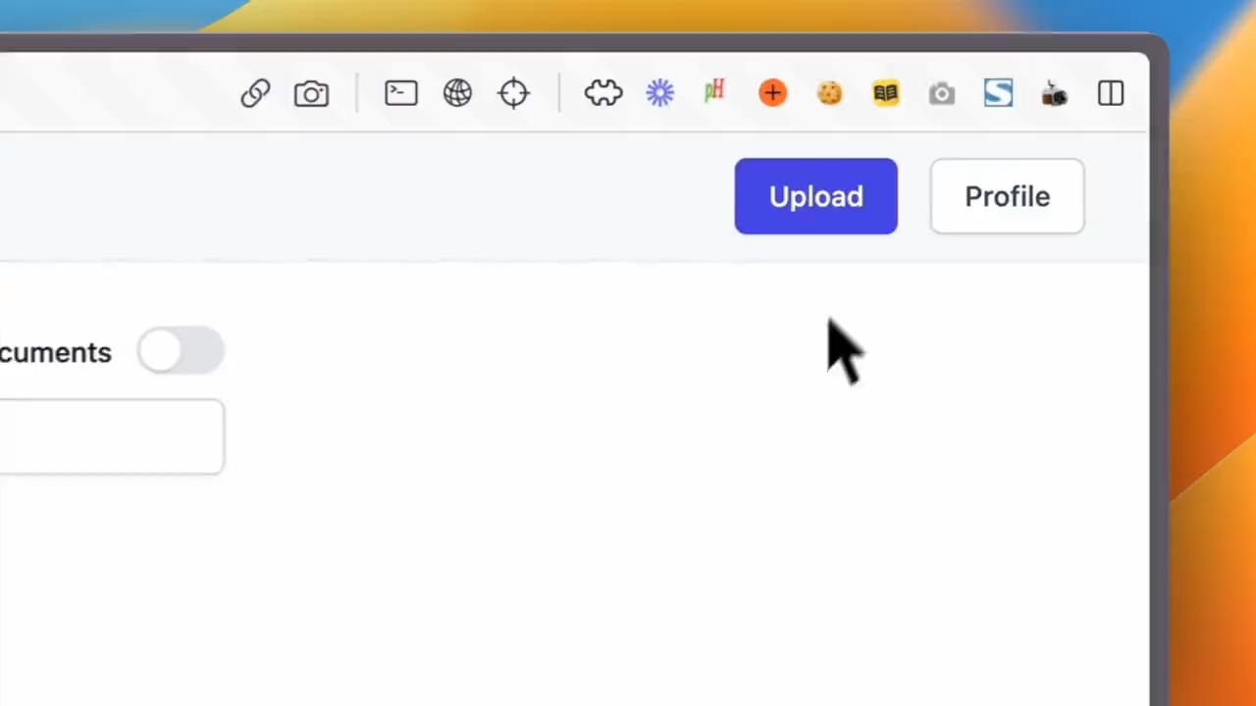
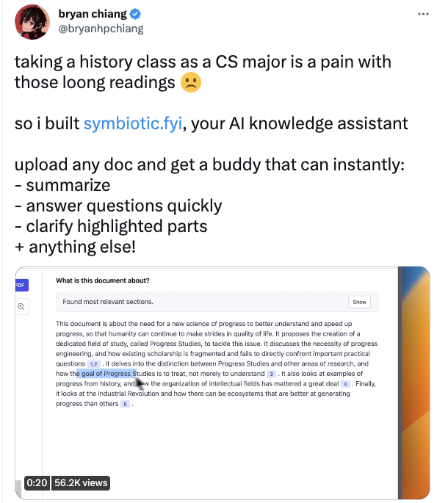
https://twitter.com/bryanhpchiang/status/1620875782074802176

Slide 51
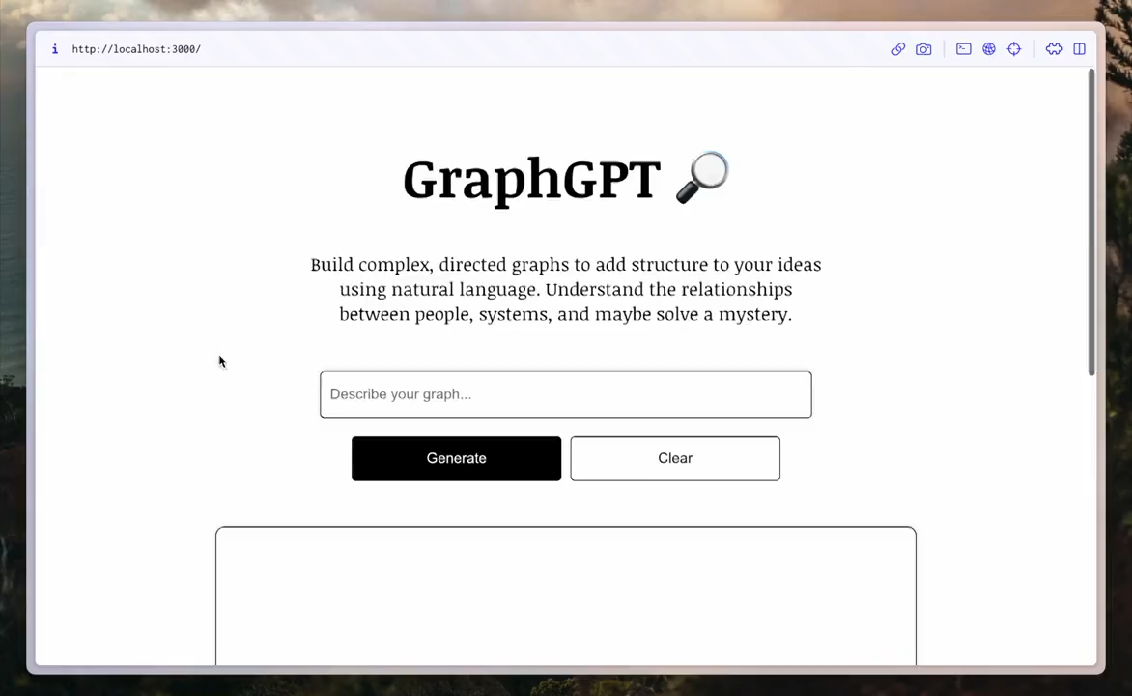
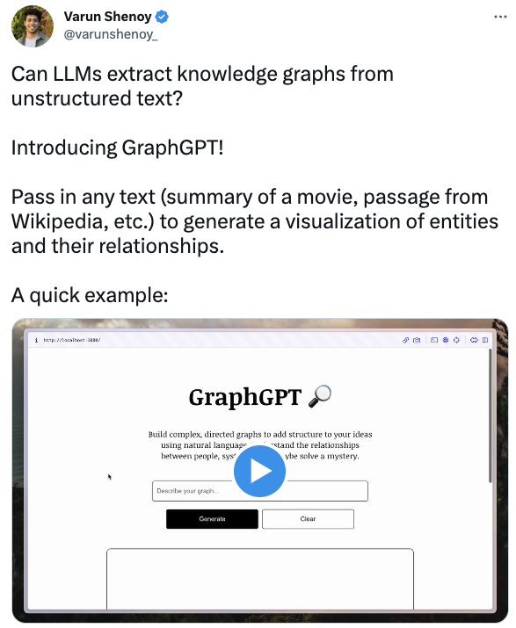
https://twitter.com/varunshenoy_/status/1620511932930490372

Slide 52
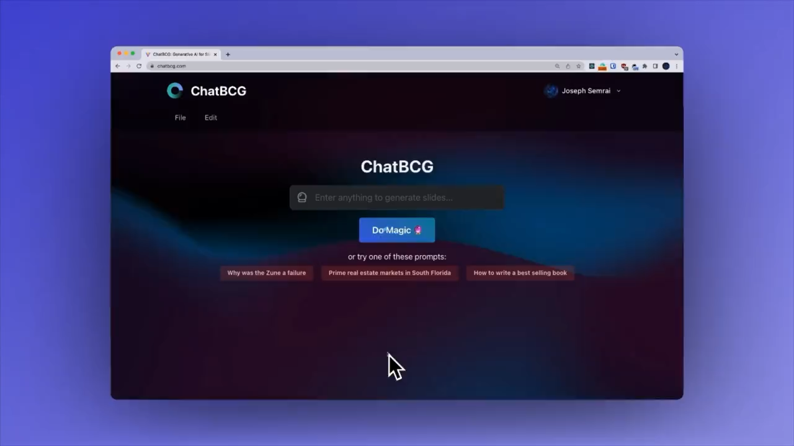
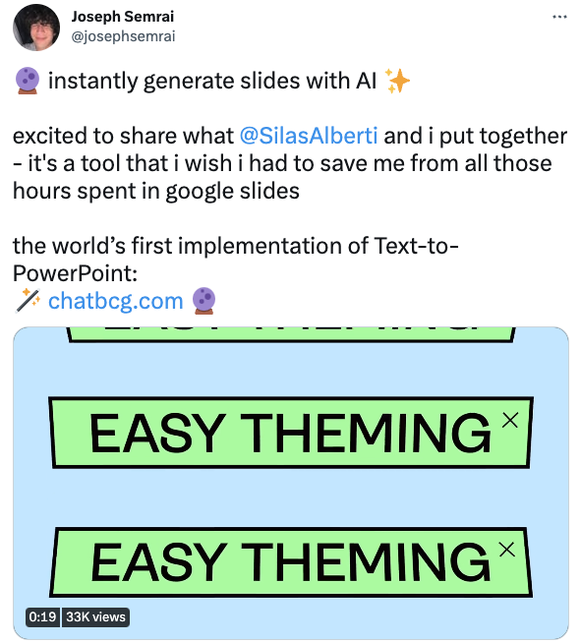
https://twitter.com/josephsemrai/status/1608039644297314304

Slide 53

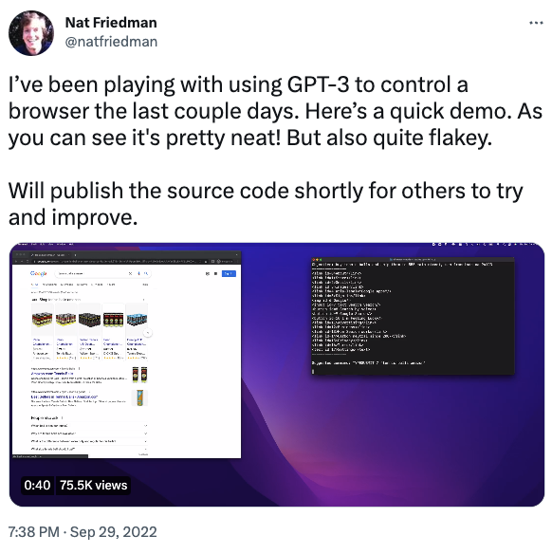
https://twitter.com/natfriedman/status/1575631194032549888

Slide 54
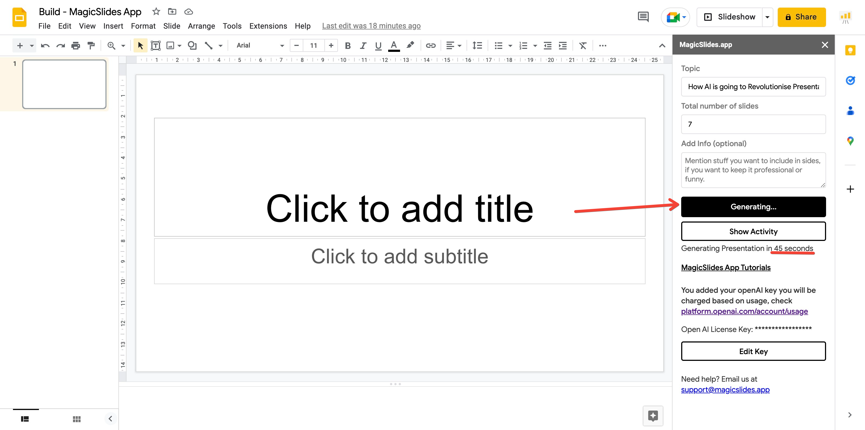
GPT for building slides
https://www.gptforslides.app/

Slide 55
GPT for building slides
https://www.gptforslides.app/

Slide 56
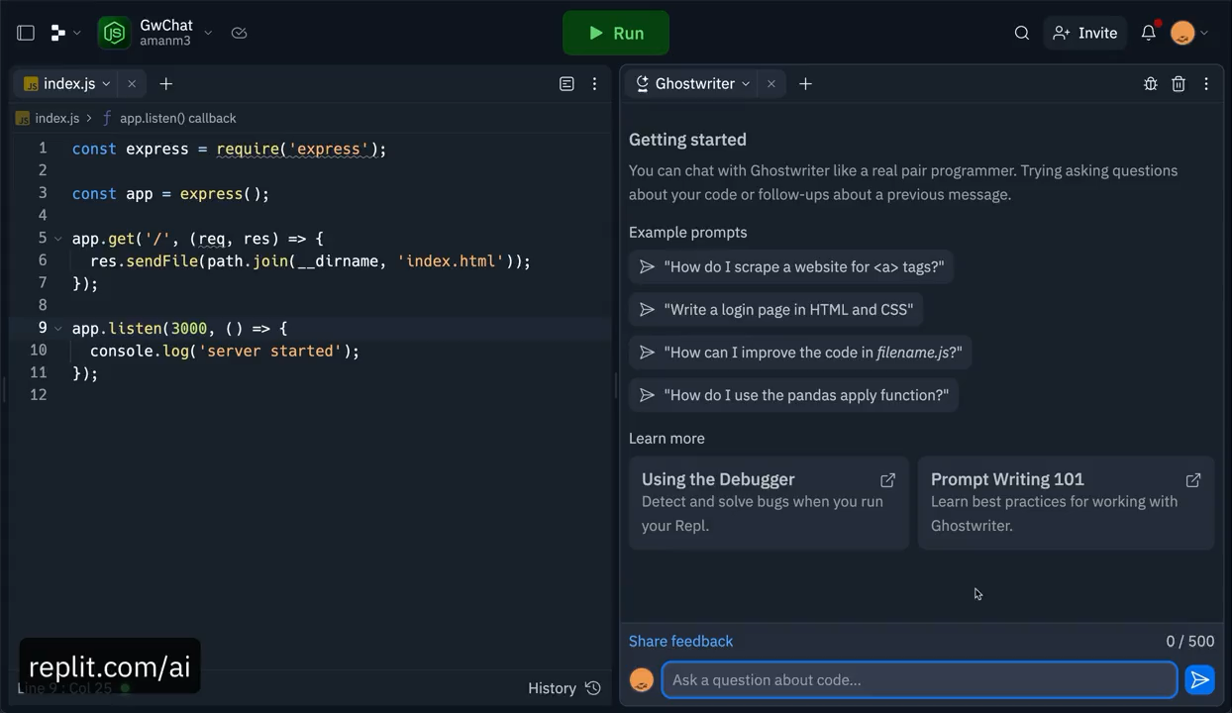
GPT for Coding
https://twitter.com/Saboo_Shubham_/status/1626174238968381440

Slide 57
You're in charge ….
Lastly, this is your chance to get your hands dirty and work on a problem that you care about.
Think broadly!

